Slide 1


Asynchronous Tasks with Django
Celery and Redis
SoftUni Team
Technical Trainers
Software University
https://softuni.org

Slide 2
Table of Contents
Asynchronous Tasks
Celery
Redis
Simple App with Celery and Redis
2
Notes:
2

Slide 3
Have a Question?
sli.do
#python-web
Notes:
3

Slide 4

Asynchronous Tasks

Slide 5
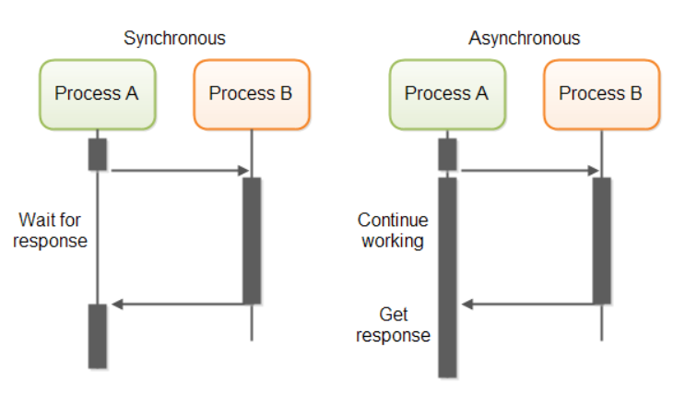
What is Asynchronous task?
Computation that runs on a background thread and whose result is published on the UI thread
When you execute something synchronously, you wait for it to finish before moving on to another task
When you execute something asynchronously, you can move on to another task before it finishes

Slide 6
Advantages
With asynchronous execution, you begin a routine, and let it run in the background while you start your next, then at some point, say "wait for this to finish"
You can execute B, C, and or D while A is still running, so you can take better advantage of your resources and have fewer "hangs" or "waits"
A -> B -> C -> D

Slide 7

What is Celery?

Slide 8
What is Celery?
Celery is an asynchronous task queue/job queue based on distributed message passing
It is focused on real-time operation but supports scheduling as well

Slide 9
Advantages
Think of all the times you have had to run a certain task in the future
Perhaps you needed to access an API every hour
Or maybe you needed to send a batch of emails at the end of the day
Large or small, Celery makes scheduling such periodic tasks easy
You never want end users to have to wait unnecessarily for pages to load or actions to complete

Slide 10

What is Redis?

Slide 11
What is Redis?
Redis is an in-memory data structure project implementing a distributed, in-memory key-value database with optional durability
The most common Redis use cases are session cache, full-page cache, queues, leaderboards and counting, publish-subscribe, and much more

Slide 12

Live Demo
Creating Simple Image Thumbnails App

Slide 13
Installing Needed Packages
Installing Redis
Download the Redis zip file and unzip in some directory
Find the file named redis-server.exe and double click to launch the server in a command window
Similarly, find another file named redis-cli.exe and double click it to open the program in a separate command window
Create a project folder and install the following dependencies
pip install Django Celery redis Pillow django-widget-tweaks
pip freeze > requirements.txt

Slide 14
Setting Up the Django Project
Create a new Django project and in it create a single app
To integrate Celery, add a new module in the app celery.py
django-admin startproject image_parroter
cd image_parroter
python manage.py startapp thumbnailer
# image_parroter/image_parroter/celery.py
import os
from celery import Celery
os.environ.setdefault('DJANGO_SETTINGS_MODULE', 'image_parroter.settings')
celery_app = Celery('image_parroter')
celery_app.config_from_object('django.conf:settings', namespace='CELERY')
celery_app.autodiscover_tasks()

Slide 15
Defining Celery Settings
Go to the project's settings and define a section for celery settings
# … skipping to the bottom
# celery
CELERY_BROKER_URL = 'redis://localhost:6379'
CELERY_RESULT_BACKEND = 'redis://localhost:6379'
CELERY_ACCEPT_CONTENT = ['application/json']
CELERY_RESULT_SERIALIZER = 'json'
CELERY_TASK_SERIALIZER = 'json'

Slide 16
Injecting Celery in Django
To ensure that the celery application gets injected into the Django application, import the it within the Django project's main __init__.py script
# image_parroter/image_parroter/__init__.py
from .celery import celery_app
__all__ = ('celery_app',)

Slide 17
Adding Tasks Module
Create tasks.py within the "thumbnailer" application
Inside the tasks.py module import the shared_tasks function decorator and use it to define a celery task function called adding_task
# image_parroter/thumbnailer/tasks.py
from celery import shared_task
@shared_task
def adding_task(x, y):
return x + y

Slide 18
Django INSTALLED_APPS
Lastly, we need to add the thumbnailer app to the list of INSTALLED_APPS
While we're in there we should also add the "widget_tweaks" application
# image_parroter/image_parroter/settings.py
INSTALLED_APPS = [
…
'thumbnailer.apps.ThumbnailerConfig',
'widget_tweaks',
]

Slide 19
Creating Image Thumbnails within a Celery Task
Back in the tasks.py module import the Image class from the PIL package
Add a new task called make_thumbnails
It should accept an image file path and a list of 2-tuple width and height dimensions to create thumbnails of

Slide 20
Creating Image Thumbnails within a Celery Task
# image_parroter/thumbnailer/tasks.py
import os
from zipfile import ZipFile
from celery import shared_task
from PIL import Image
from django.conf import settings
@shared_task
def make_thumbnails(file_path, thumbnails=[]):
os.chdir(settings.IMAGES_DIR)
path, file = os.path.split(file_path)
file_name, ext = os.path.splitext(file)
zip_file = f"{file_name}.zip"
results = {'archive_path': f"{settings.MEDIA_URL}images/{zip_file}"}
# Continues on the next slide

Slide 21
Creating Image Thumbnails within a Celery Task
# Continues from the previous slide
try:
img = Image.open(file_path)
zipper = ZipFile(zip_file, 'w')
zipper.write(file)
os.remove(file_path)
for w, h in thumbnails:
img_copy = img.copy()
img_copy.thumbnail((w, h))
thumbnail_file = f'{file_name}_{w}x{h}.{ext}'
img_copy.save(thumbnail_file)
zipper.write(thumbnail_file)
os.remove(thumbnail_file)
img.close()
zipper.close()
# TODO: catch IOError and return the result

Slide 22
Setup Media Root and URL
Give a MEDIA_ROOT location where image files and zip archives can reside, specify the MEDIA_URL where the content can be served from
# image_parroter/settings.py
STATIC_URL = '/static/'
MEDIA_URL = '/media/'
MEDIA_ROOT = os.path.abspath(os.path.join(BASE_DIR, 'media'))
IMAGES_DIR = os.path.join(MEDIA_ROOT, 'images')
if not os.path.exists(MEDIA_ROOT) or not os.path.exists(IMAGES_DIR):
os.makedirs(IMAGES_DIR)

Slide 23
Creating the View
# thumbnailer/views.py
import os
from celery import current_app
from django import forms
from django.conf import settings
from django.http import JsonResponse
from django.shortcuts import render
from django.views import View
from .tasks import make_thumbnails
class FileUploadForm(forms.Form):
image_file = forms.ImageField(required=True)
# Continues on the next slide

Slide 24
Creating the View
class HomeView(View):
def get(self, request):
form = FileUploadForm()
return render(request, 'thumbnailer/home.html', { 'form': form })
def post(self, request):
form = FileUploadForm(request.POST, request.FILES)
context = {}
if form.is_valid():
file_path = os.path.join(settings.IMAGES_DIR, request.FILES['image_file'].name)
with open(file_path, 'wb+') as fp:
for chunk in request.FILES['image_file']:
fp.write(chunk)
task = make_thumbnails.delay(file_path, thumbnails=[(128, 128)])
context['task_id'] = task.id
context['task_status'] = task.status
return render(request, 'thumbnailer/home.html', context)
context['form'] = form
return render(request, 'thumbnailer/home.html', context)

Slide 25
Creating the View
class TaskView(View):
def get(self, request, task_id):
task = current_app.AsyncResult(task_id)
response_data = {
'task_status': task.status,
'task_id': task.id
}
if task.status == 'SUCCESS':
response_data['results'] = task.get()
return JsonResponse(response_data)

Slide 26
Adding the URL's
Add a urls.py module inside the thumbnailer application and define the following URLs
# thumbnailer/urls.py
from django.urls import path
from . import views
urlpatterns = [
path('', views.HomeView.as_view(), name='home'),
path('task/<str:task_id>/', views.TaskView.as_view(), name='task'),
]

Slide 27
Creating the Template
Next, begin building out a simple template view for a user to submit an image file
The user should be able to:
Check the status of the submitted make_thumbnails tasks
Initiate a download of the resulting thumbnails
To start off, create a directory to house this single template within the thumbnailer directory
Use the HTML file from here
Test your application on http://localhost:8000

Slide 28

Summary
When you execute something asynchronously, you can move on to another task before it finishes
Celery is an asynchronous task queue/job queue based on distributed message passing
Redis is an in-memory data structure project
Notes:
28

Slide 29
Questions?
Notes:
29

Slide 30

License
This course (slides, examples, demos, exercises, homework, documents, videos and other assets) is copyrighted content
Unauthorized copy, reproduction or use is illegal
© SoftUni – https://softuni.org
© Software University – https://softuni.bg
Notes:
30

Slide 31
Trainings @ Software University (SoftUni)
Software University – High-Quality Education, Profession and Job for Software Developers
softuni.bg, softuni.org
Software University Foundation
softuni.foundation
Software University @ Facebook
facebook.com/SoftwareUniversity
Software University Forums
forum.softuni.bg
Notes:
31

